Slide 1
Suggested Replies Review
Notes:
https://docs.google.com/spreadsheets/d/16DnYfCJFKFQdCRii6YQusgWWO13e0gNyj7eBSY7mBdQ/edit#gid=1227971487

Slide 2
Agenda
Replies Statistics
Platform specific hardcoded replies logic
Way Ahead in Centralization
Current ML Suggestive Reply Flow
Buyer/Seller replies intents
Way ahead in ML Model Service

Slide 3
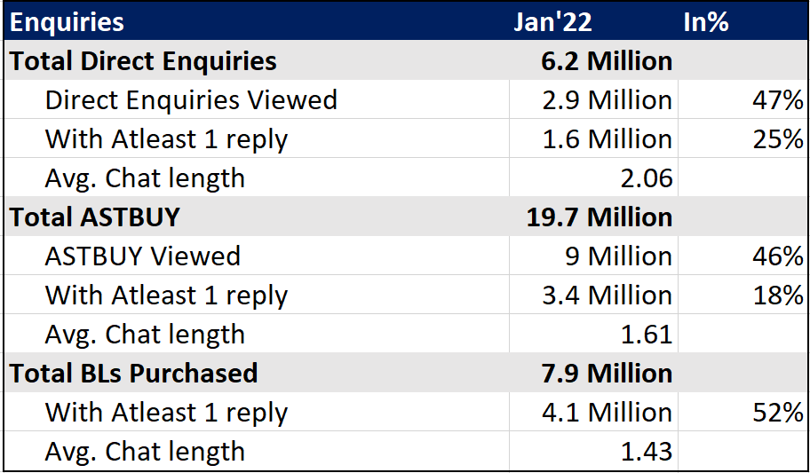
Direct Enquiries, ASTBUY and BL

Slide 4
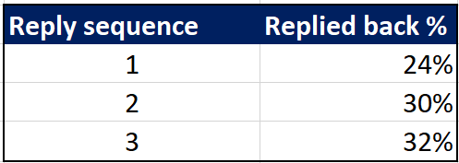
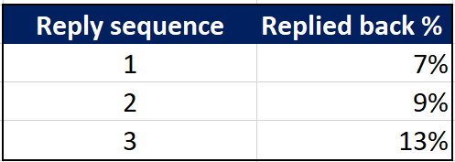
Replies replied to analysis
BUYER
SELLER
No. of replies
by buyer
Replied back
by seller
No. of replies
by seller
Replied back
by buyer
Implies, only 24% of the replies with reply sequence 1 i.e. 1st message sent by buyers are answered/replied back by the sellers
Implies, only 7% of the replies with reply sequence 1 i.e. 1st message sent by sellers are answered/replied back by the buyers

Slide 5
Platform Specific Hard Coded Replies Logic Overview

Slide 6
Desktop LMS
Ask for Review
Last Reply
Catalog Link
Static Temp (5)
ML (5)
User Defined
Payment
Link
Shown only when there is message from other side
only for Paid seller
Paid seller - 1st position
Free seller - 3rd position
Ctype - NA
SAAB- NA
Shown only when there is no message from other side
Shown vertically when enq is received. They become horizontal after 1 reply from seller
Different static templates for buyers and free sellers

Slide 7
Desktop LMS
>> Static Templates (Seller) -
We show 5 templates out of a list of 8 templates:
Can you share your contact details?
Let me know suitable time to talk
Please share more details of requirement
Thanks for your enquiry. We will revert shortly.
What is the order value?
What is the quantity?
What is the quantity and order value?
Yes, product is available
>> Static Templates (Buyer) -
Waiting for your reply
What will be the minimum quantity and best price?
I need some samples before placing the order
Do you deliver in:
Is the product currently in stock?

Slide 8
Android LMS
Vertical Templates [ 3 x 2 Grid ] (Only When Enq/BL received and no reply is sent)
Catalog Link
ML (5)
Horizontal Templates (closes the vertical templates or after at least 1 sent)
Last Reply
ML (5)
Static Templates(6)
User Defined
**Note:
In case of SAAB when only the Enq. is sent:
Static Vertical templates are shown (2 x 2)
Horizontal Templates [ Last Reply, Static Templates (12) ]

Slide 9
Android LMS
Static Templates
1. What is the order quantity? (no messages exchanged - 1st position, at least 1 message exchanged - last position)
2. Here is my catalog link
3. Please share more details about the requirement
4. Let me know a suitable time to talk (Label = Time to Talk ?)
5. Let us discuss on call (Label = Discuss on Call)
6. Plus GST (Label = Taxes Extra)
Send payment Link ( at least 1 message exchanged - 2nd position)
SAAB Static templates
1. Request Quotation Template
2. Sahi Rate ?
3. Time to talk ?
4. Quotation bhejo Template
5. Approx Price
6. Aur details ?
7. Share pictures
8. Kab baat kare?
9. Pics Bhejo
10.Please reply
11. More details?
11. Kitna discount
12. Offers/Discount

Slide 10
Desktop BMC
Last Reply
Catalog Link
Static Templates(6)
ML (5)
User Defined
Shown only when there is message from other side or when enq is received
Only for free seller, shifted behind static templates after 2 replies sent by the seller
Shown only when there is no message from other side and enquiry is sent

Slide 11
Desktop BMC
Enquiry Reply Box and Others
Buyer
Say Hi
Request Call back
Seller
Request More Details
Yes, product is available
Others:
Last Reply (2 days later Follow Up)
Call Incoming (2 days later Follow Up)
Call Incoming( 2 days later Request Call Back)
Call Outgoing (2 days later Follow Up)
Call Outgoing ( 2 days later Request Call Back)
>> Static Templates -
Waiting for your reply
What will be the minimum quantity and best price?
I need some samples before placing the order
Do you deliver in:
Is the product currently in stock?

Slide 12
M-Site
Static Templates (6)
ML (max 5)
Shown only when there is message from other side
For Buyers: 5 ML replies are shown in horizontal manner
For Free Sellers: 3 ML replies are shown vertical, when clicked on any one of them or on the chat area, 5 ML horizontal templates are shown
Shown only when enq. is sent/received and there is no message from other side
** Note:
Static Templates are different for Buyer & Free seller

Slide 13
M-Site
For Buyers (Static):
1. Hi, <Seller Name> - Hi, <Seller Name>!
2. Share price details - What is the approximate price?
3. Need product details - I need more details about the product.
4. Send product photos - Kindly send more photos of this product.
5. Waiting for reply - I am waiting for your reply.
6. Is product in stock? - Is this product currently in stock?
For Free Sellers (Static):
1. Hi, <Buyer Name> - Hi, <Buyer Name>!
2. Request order quantity - What is the order quantity?
3. Send more details - Please send more details about your requirement.
4. Request call-back - Please call me back whenever you are free.
5. Waiting for reply - I am waiting for your reply.
6. Ask delivery location - Where do you want the order to be delivered?

Slide 14
Android BMC
Vertical Templates [ 3 x 2 Grid ] (Only When Enq/BL is sent/received)
Static Templates (6)
Different static templates as compared to Horizontal Static templates
Horizontal Templates (closes the vertical templates or after at least 1 sent)
Last Reply
ML (5)
Static Templates(8)
User Defined
Shown only when there is message from other side or when enq is received
Different Templates for
Buyer and Free seller
Notes:
Vertical vs horizontal

Slide 15
Android BMC
Vertical Templates (Buyer - Only enq sent case):
1.Required quantity piece is: (will be shown until quantity is missing)
2. Hi <buyername> (shown only when last message in the thread is older than 24 hours)
3. Approximate Price
4. Request Quotation
5. More details
6. Share Pictures
7. Please reply
Buyer side templates
1.Required quantity piece is:
(shown until quantity is unfilled)
2. Last Reply
3. Hi <buyername>
3.Time to Talk?
4.Request for Payment Link
5.Approx. Price?
6.Request Quotation
7.More details?
8.Please reply
9.Share Pictures
10.Offers/Discounts
Free Seller side templates
1.Last Reply
2.Hi <buyername>
3.What is the order quantity?
4.Here is my catalog link:-
5.Please share more details about the requirement.
6.Time to Talk?
7.Discuss on Call
8.Taxes Extra

Slide 16
IOS LMS
Vertical Templates [ 2 x 2 Grid ] (Only When Enq is received)
Vertical Templates [ 3 x 2 Grid ] (Only When Enq is sent)
Static Templates (4)
Static Templates (6)
1. Here is my catalog link
2. Displays 3 ML based templates
1. Hi <name>
2. Displays 5 ML based templates
Horizontal Templates (closes the vertical templates or after at least 1 sent)
Static Templates(5)
ML (5)
User Defined
Different templates for
free seller and buyer
ML is only hit if last msg is Enq/BL

Slide 17
IOS LMS
Static Templates - Free Seller:
1. Ask Quantity
2. Share More Details
3. Here is my catalog link:
4. Share company detail
5. Payment Link
Static Templates - Buyer:
1. Request Reply
2. Time to Talk?
3. Payment Link
4. My Last Reply

Slide 18
IOS BMC
Vertical Templates [ 3 x 2 Grid ] (Only When Enq is sent/received)
Static Templates (6)
Different static templates as compared to horizontal ones
Horizontal Templates (closes the vertical templates or after at least 1 sent)
Static Templates(7)
Last Reply
User Defined

Slide 19
IOS BMC
Static Horizontal Templates:
1. Request Reply (Only shown in enq sent and C type initiation case)
2. Time to Talk?
3. Request Payment Link
4. Price?
5. Request Quotation
6. Share More Details
7. Whatsapp Number
Static Vertical Templates:
1. Hi <name>
2. Approx. Price?
3. Request Quotation
4. More details?
5.Share Pictures
6. Please reply

Slide 20
Way Ahead - Centralization of replies for only enq. case
Objective
Improve 1st suggested response accuracy and effectiveness leading to more depth of conversation
Same experience across all platforms by removing hardcoded logic at platform level by bringing it under the centralized API
What will be done?
1. 90% of suggested replies are chosen from top 6 positions - 6 suggestions would be shown
2. For Seller - Last Reply, ISQ (max 3) , Static (min 3, with at least 1 suggestion in hinglish), User Defined
3. For Buyer - Last Reply, ISQ (max 2) , Static (min 4, with at least 1 suggestion in hinglish), User Defined
4. Attaching "Hi <name>," before the message
5. To track usage of ISQ based suggestion a new template flag would be used

Slide 21
Way Ahead - Centralization of replies for only enq. case
Buyer Suggestions from Centralized API
Price
Photos
Call / Reply
More Details
Quotation
Availability
17% 11% 11% 8% 6% 2%
As per Buyer Intent Weightage
Seller Suggestions from Centralized API
Catalog Link
Call / Reply
More Details
Quantity
Availability
Revert shortly
25% 7% 5% 4% 3% 1.5%
As per Seller Intent Weightage

Slide 22
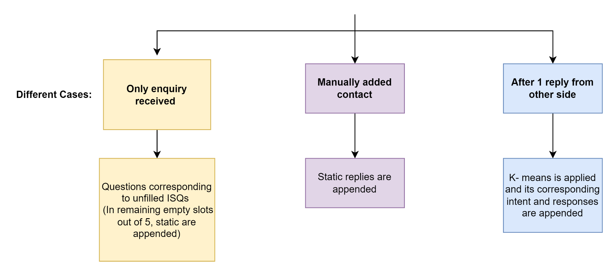
Current ML Suggestive Reply Flow

Slide 23
Seller and Buyer Intents
Seller
Buyer
Existing Intents | New Intents
Requirement | Greeting
Product details | Whatsapp
Send Pictures | Rating/Review
Availability | Quantity
Sample cluster | Catalog link
Quotation | Service
Price | ISQ
Reply Request | Call / Email
Payment terms | Buying Intent
Shipping Charges | Social media
COD | Time to talk
Address Details
Delivery
Existing Intents | New Intents
Requirement | Greetings | Subscription
Product Details | Whatsapp | Product List
Picture | Follow Up / reply | Service
Quantity | GST/Taxes/Charges | Sell
Catalog link | ISQ | Time to talk
Availability | Address/Location | Sample
Supply Details | Order | Single Piece
Price | Call / Email | Interested/Require
Payment | Discount/Offer
Shipping | Bulk/Wholesale
Delivery Details | Quotation
Order Details | Resell/etc.
Visit request | EMI/Installments

Slide 24
Way Ahead - Updating Intents and Responses
Adding the new intents and refining the responses as per current data
Clustered replies for identifying new intents and response
How will it help?
Replacing the unused suggestion or less used ones with more contextual and frequently used replies. This would help us increase the usage of Suggested replies

Slide 25
Way Ahead - Updating ISQ Suggestions
ISQs of new MCATs to be added
Showing ISQ based questions and answers to sellers/buyers as per ENQ/BL received
What will be changed?
18,000 new MCATs will be added
162536 new ISQs will be added

Slide 26
Way Ahead - Buyer Side ISQ based responses
Showing exact suggestion to buyers for seller based ISQ questions
For Example,
A buyer sends an enquiry for a pen
Then seller asks which color you want?
Buyer will be suggested : Black, Blue, Red
How will it help?
This upfront suggestions will help buyers to respond quickly and accurately, which can reduce the response time and depth of the conversation

Slide 27
Way Ahead- Introduce Yourself New Template
A template which would help sellers introduce themselves to buyers
How will it help?
Approximately 15% user defined templates are used out of which 55% of them are based on introduction, which we can move to our Suggestive reply service which would increase the usage of overall suggestive replies.

Slide 28
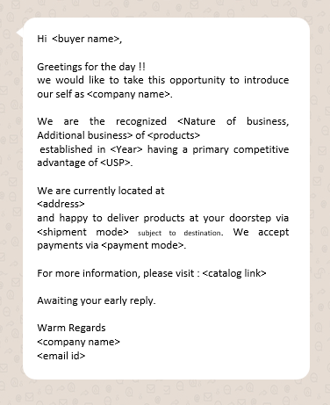
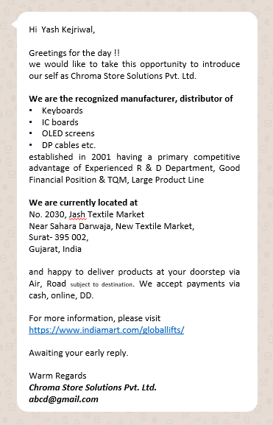
Way Ahead - Introduce Yourself New Template

Slide 29
Thank You

Slide 30
ML Top Responses used
Seller ML Responses - (% out of total ML responses sent by seller) | Buyer ML Responses - (% out of total ML responses sent by buyer)
What is the quantity and order value? - 58% | Waiting for your reply - 16.5%
What is the order value? - 12% | What will be the minimum quantity and best price? - 8.9%
What is the quantity? - 10% | What is the total cost, including gst and shipping charges? - 7%
Share more details of requirement - 6% | Send me product images with prices here - 7%

Slide 31
User Defined replies analysis
Intent | % replies with intent | % of sellers using
Introduction (contains company details, phone no, address, email, product details) | 54.57% | 65%
Call / WhatsApp information | 14.13% | 45%
Product Availability | 11.83% | 30%
Product Detail | 13.15% | 25%
Contact Details | 1.07% | 10%
Enrich Requirement | 2.01% | 10%
Export | 0.85% | 10%
Delivery | 0.85% | 5%
Location of shop | 0.17% | 5%
Follow up when no reply | 0.09% | 5%
Payment | 0.13% | 5%
Price & Delivery | 1.15% | 5%

Slide 32
User Defined replies analysis
B | 1 | what is the approximate price for this product? | android
S | 2 | we thank you for your inquiry. we will share the formal email shortly. please go through with our catalogue link for more details:- www.amaragriindia.com or contact us at our hotline number via whatsapp at 8437037043 / 9465372752 / 9915592964 | sellermy
B | 1 | i need more details about the product. | imob
S | 2 | respected dear customer we are glad that you contacted us through online medium for your query we wish we will answer you shortly regarding your enquiry asap. ------------------------------------------------------------------------------------- in case of any inconvenience or late reply please call u s on given mobile number 9334777330 9304009140 whats app on 9304102827 email : support@patnacomputers.com --------------------------------------------------------------------------------------- our website link please visit : https://www.uttamcomputer.com/ https://patnacomputers.com/ --------------------------------------------------------------------------------------- office address : the uttam computers vermar karpura house s.p verma road near dakbanglow chauraha patna 800001 google map link : https://g.page/the-uttam-computers?share 2nd office location : patna computers private limited migh 298 lohiya nagar kankarbagh patna google map link :https://goo.gl/maps/bqyvmfg3zega4ntw6 ---------------------------------------------------------------------------------------- | sellermy

Slide 33
IOS LMS
Other Cases
Listing Screen:
1. Ask Quotation
2. Request Reply
>> These static templates are shown when new contact is added within 24 hours and no message or call was exchanged.

Slide 34
IOS LMS
Other Cases
Who viewed your catalog
1. Share catalog link
2. Ask for time to talk
Listing Screen:
Two static templates are shown after 48hrs of contact added date:
1. Share catalog link
2. Ask for time to talk
Only when, if there is no activity (reply/call) within 48 hours of last contacted date

Slide 35
Android BMC
Other Cases
Call popup - Picked Call - No:
Hi, Thanks for your requirement. We tried calling you but couldn’t connect. Kindly call for more details
Call popup - Picked Call - Yes:
Hi <username>, I tried to call you about my requirements but it did not connect. Kindly call me to get the complete details.
Listing Screen:
1. Ask Quotation
2. Request Reply
>> These static templates are shown when new contact is added within 24 hours and no message or call was exchanged."

Slide 36
M-Site
Other Cases
Call Popup - Picked Call - Yes:
Ask Quotation
Ask catalogue
Call popup - Picked Call - No:
Time to talk
Ask catalogue
Widgets & Dropdown
Ask for Details - Can you share more details about this requirement?
Request Callback - Can you please call to discuss this?
LISTING SCREEN: In case of unread message for a thread -
>> We show 2 static templates to buyers:
1. More Details - Can you share more details on this product?
2. Request Call Back - Can you please call to discuss this?
>> We show 1 static templates to sellers:
1. Ask for More Details - Can you share more details on this product?

Slide 37
Android LMS
Other Cases
Who viewed your catalog:
Share catalog link
Ask for time to talk
Call popup - Picked Call - No:
Hi <name>, Thanks for your requirement. We tried calling you but couldn’t connect. Kindly call for more details
Call popup - Picked Call - Yes:
Hi <name>, Thanks for your requirement. It was nice talking to you. Will share further details soon.
Listing Screen:
Two static templates are shown till 48 hrs until a reply is sent/ activity is done:
1. Share catalog link (lands on LMS Mini Catalog)
2. Ask for time to talk

Slide 38
Desktop BMC
Widgets & Dropdown
1. Enq. Sent
Say Hi, Request call back
2. Waiting for your reply - Unread
Follow-up, Request Call Back
3. Waiting for your reply - Read
Say Hi, Request Call Back
4. Catalog link - Unread
Say Thanks, Request Product photos
5. Catalog link - Read
Follow-up, Request Product photos
6. Call attempted - Incoming - Unread
Follow-Up, Request Call Back
7. Call attempted - Incoming - Read
Follow-Up, Request Call Back
8. Attachment "Please find attachment" - Unread
Say Thanks, Request Catalog
9. Attachment "Please find attachment" - Read
Follow-up, Request Call Back
10. Any message other than above - Unread
Ok Thanks, Please Call

Slide 39
Desktop LMS
Other Cases
Who viewed your catalog section
Interested in this product?
Catalog Link
Best time to talk?
BL Purchase Pop up Section
Default
More Details
Time to talk
User Defined
Price
Payment Details

Slide 40
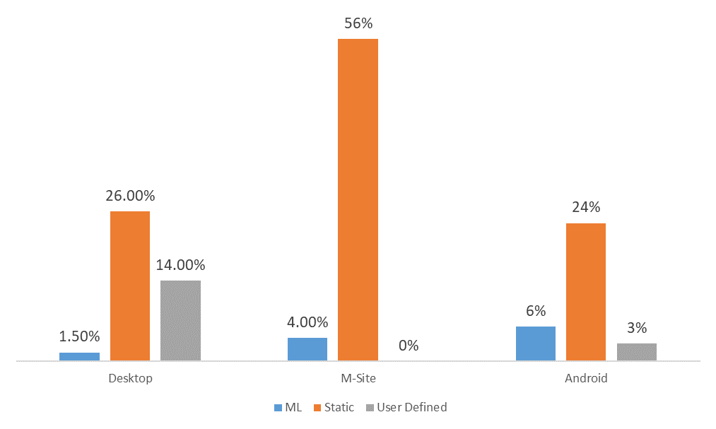
Usage of ML, Static & User Defined replies across platforms

